Slide 1
DeepSeek-Janus
Focusing on the Method

Slide 2
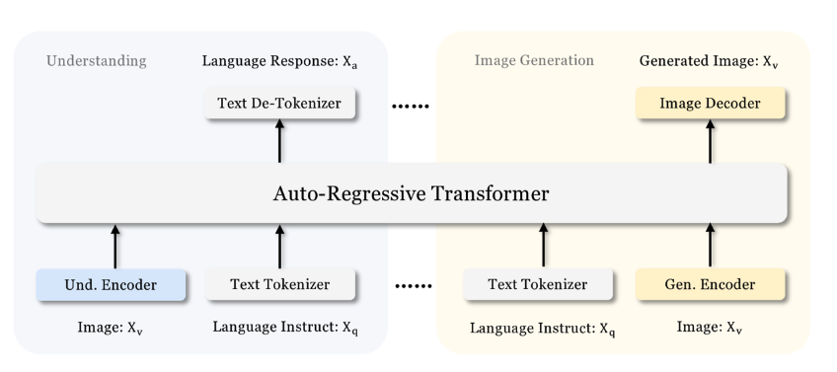
DeepSeek-Janus
Based on Auto Regressive Transformer
다음 토큰을 예측하는것이 기본적인 동작 방식

Slide 3
DeepSeek-Janus
Janus multimodal understanding
Pure Text
Understanding
LLM built-in tokenizer
Text
convert
Discrete IDs
Tuned for text prediction
Built-in prediction head of LLM
LLM input space
mapped feature
Multimodal
Understanding
mapping
Understanding Adaptor
1-d seq
Color coding
Task
Module
Data
tuned
Flatten
Image
SigLIP
encoding
High dim Feature

Slide 4
DeepSeek-Janus
Based on Auto Regressive Transformer
다음 토큰을 예측하는것이 기본적인 동작 방식

Slide 5
DeepSeek-Janus
Color coding
Task
Module
Data
tuned
Janus visual generation
Image
VQ tokenizer from “Llama Gen”
Discrete ID
flatten
1-D vector
Generation Adaptor
Generated Image
Mapping ID : codebook embedded
Processing
Randomly initialized
prediction head LLM
LLM
Multimodal
Feature seq
Feature Sequences
(Codebook friendly mapped vector)
concat

Slide 6
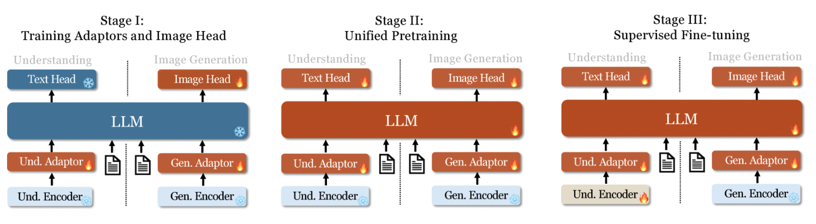
Before Training Session
LLM 학습의 Traditional 한 방식대로 진행됨
Adaptor 저놈이 뭐냐 <- finetuning 을 쉽게 하게 해주는녀석
LLM 튜닝을 위한 Skill
작은 모듈 붙여서, 그것들만 학습시키면서 성능을 증가시킴

Slide 7
1 stage
Adaptor 활용
Visual understanding 과 linguistic understanding 의 embedding space 를 맞추기 위한 과정

Slide 8
2 stage
간단한 이미지 생성을 학습 시킴 (imagenet-1k)
Text-to-image 데이터셋 활용하여
Open-domain 모델로 발전시킴

Slide 9
3 stage
Instruction following 에 집중
Supervising answer

Slide 10
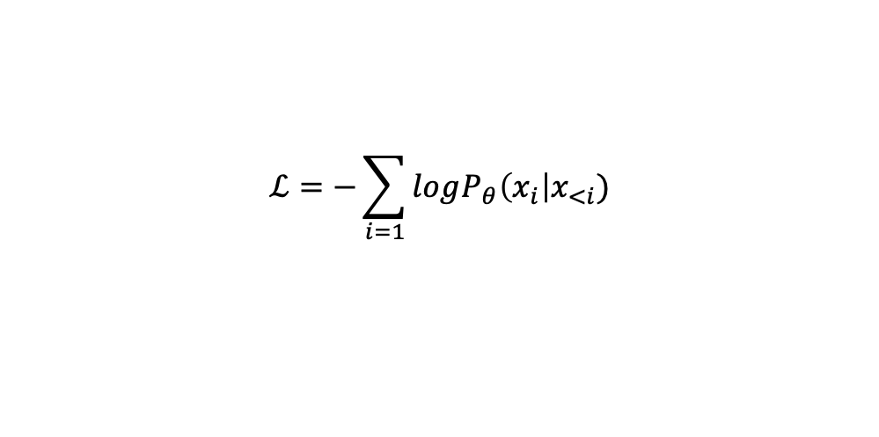
Training Objective
Understanding task : compute the loss on the text seq
Generation task : compute the loss only on the image seq
$$ℒ=−\sum_{i=1}{logP_{θ}\left(x_{i}\right|x_{<i}})$$

Slide 11
DeepSeek-VL2
Focusing on the Method

Slide 12
DeepSeek-VL2
📌Key Points
It begins in March 12

Slide 13
DeepSeek-Janus Flow
Focusing on the Method

Slide 14
DeepSeek-Janus Flow
📌Key Points
On the Basic model of Janus
Applied Rectified Flow

Slide 15
Rectified Flow
It begins in March 12

Slide 16
DeepSeek-Janus Pro
Focusing on the Method

Slide 17
DeepSeek-Janus Pro
📌Key Points
Up Scaled DATA
UpScaled Model
Longer Training for stage I
Increase training steps
Focused Training for stage II
Applied text-to-image data directly

Slide 18
Janus vs Janus Pro
 | Janus | Janus-pro | 비고
Base | Autoregressive-transformer | Autoregressive-transformer | 동일
Architeture |  |  | 동일
Training | 3 Stage | Longer Stage 1 & Changed Stage 2
Data for stage II |  | More Data (refer to VL2 and add 90million samples
Data for stage III |  | incorporate additional datasets from VL2(MEME understanding, Chinese conversation) for enhance dialogue experiences

